Slide 1


Slide 2


Slide 3



Muhammad Idrees (16CS78)
Saifullah Soomro (16CS94)
Mujeera Noor Thebo (16CS22)
Inamullah Memon (16CS76)
Mansoor Ahmed Jumani (16CS162)
Lead by Muhammad Waris(16CS44)
Supervisor : Dr. Moazzam Jawed

Slide 4


Slide 5






Prone to vote tampering
Time consuming method
of counting
Questionable results

Slide 6

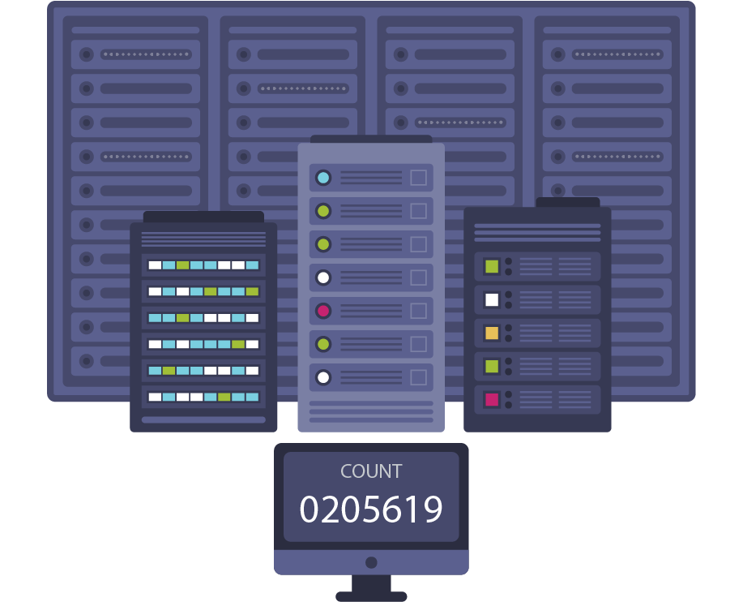
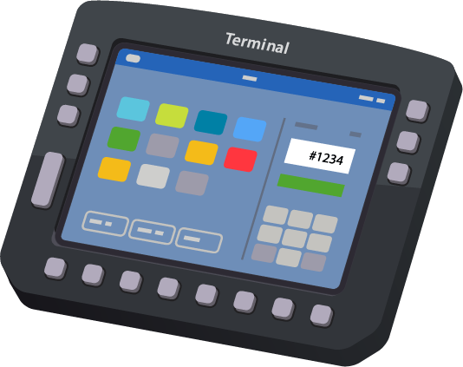
Voter authentication
Digitalized counting carried
out by a central server
Questionable results

Slide 7


Slide 8
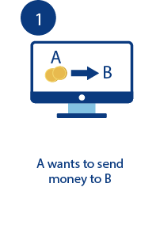
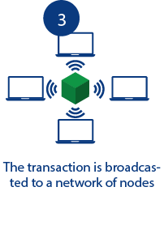
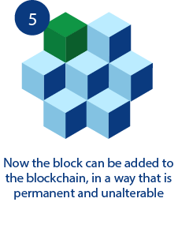


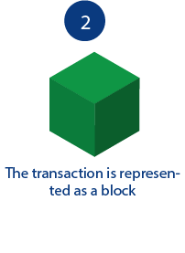
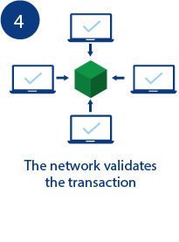
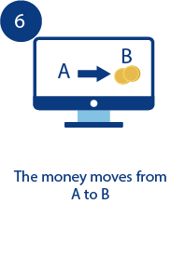

Slide 9


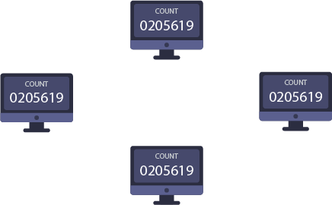
Voter authentication
Distributed ledger and
less counting time than
conventional voting
Trusted and publicly
verified results

Slide 10

Canada implemented E-voting in 2012. However, for part of a day the online voting server was effected by Denial-Of -Service attack. [1]
iVote implemented E-voting in Australia in 2015, there were several reports that over 66,000 votes were compromised due to cyber attack. [2]
Bitcoin is built using Blockchain on top of which you can build applications, currency is just one. [3]
Agora a startup company is also working on making elections better by using blockchain. [4]
The South Korean government is considering using blockchain technology for an electronic voting system. [5]

Slide 11

TAMPER-PROOF
Ballots and results cannot be altered by any third party.
TRANSPARENT
The entire voting process is fully transparent and publicly verifiable.
PRIVATE
Voters’ choices and identities are protected.
ACCESSIBLE
Voters can cast vote from their nearest polling station.

Slide 12





Slide 13

A working prototype of DE-VOTE to be exhibited in the Project Exhibition which can further be proposed to Election Commission of Pakistan for the implementation of Decentralized E-voting System.

Slide 14

K. Wüst, "Do you need a Blockchain?," in 2018 Crypto Valley Conference on Blockchain Technology, 2018.
D. P. Moynihan, "Building Secure Elections: E‐Voting, Security, and Systems Theory," Public Administration Review, vol. 64, no. 5, pp. 515-528, 2004.
A. M. A. HTET NE OO, "A Survey of Different Electronic Voting Systems," International Journal of Scientific Engineering and Technology Research, vol. 3, no. 16, pp. 3460-2464, 2014.
B. R. Rifa Hanifatunnisa, "Blockchain Based E-Voting Recording System," in 11th International Conference on Telecommunication Systems Services and Applications (TSSA), Lombok, 2017.

Slide 15
[1] Mulcair handed NDP reins; Successor to Layton faces big challenges". Calgary Herald, March 25, 2012. [2] Michael Safi. "NSW election result could be challenged over iVote security flaw". The Guardian. Archived from the original on 2016-11-24. [3] B. Marr, "forbes.com," forbes, 16 02 2018. [Online]. Available: https://www.forbes.com/sites/bernardmarr/2018/02/16/a-very-brief-history-of-blockchain-technology-everyone-should-read/#6e81ced47bc4. [Accessed 04 12 2018]. [4] Agora, “agora.vote," Agora, 2018. [Online]. Available: https://agora.vote [Accessed 05 11 2018]. [5] M. Yakubowski, "cointelegraph.com," Coin Telegraph, 28 11 2018. [Online]. Available: https://cointelegraph.com/news/south-korean-government-to-test-blockchain-use-for-e-voting-system. [Accessed 28 11 2018].

Slide 16


Slide 17
Table of content
Introduction
Conventional Voting System.
What is blockchain and how it works?
How blockchain can improve the voting system.
Related work
Problem statement
Aims and Objectives
Proposed tools
References

